Slide 1

TAM: multi-Touch, mid-Air, and Motion for Virtual and Augmented Reality Version 6.0 Learning Data Structures with Augmented Reality for Computer Science Education (K-12)
Team Members: Tom Lam, Ramses Sanchez Product Owner: Dr. Francisco Ortega
Instructor: Masoud Sadjadi School of Computing and Information Sciences Florida International University
Final Presentation
Spring 2017
Notes:
7 seconds.( I will select 2 best slides (i will give them extra points and students will present for CIS committee)
Greet your audience, thank them for attending your presentation, introduce yourself, introduce your project, introduce your team members, and quickly indicate what each of you did in a high-level manner, and put more emphasis on your part/contribution.

Slide 2


Project definition
Sample AR marker; it could be anything the user wants it to be as long as the image is high resolution.
Notes:
10 seconds.
Introduce the problem that the whole project (in all versions) tackles with GIF or screenshot.

Slide 3
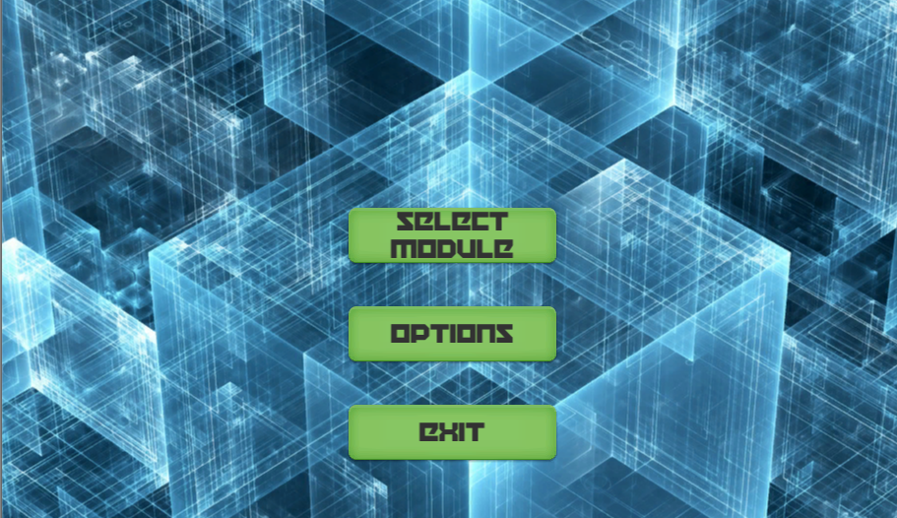
Project definition
Screenshots or GIF pictures of the new version
Once the software has loaded, the user can change Options, Exit, or Select a Module (Data Structure Visualization) to display.
Notes:
20 seconds.
Introduce the problem that the your project (in new version) tackles with GIF or screenshot.

Slide 4
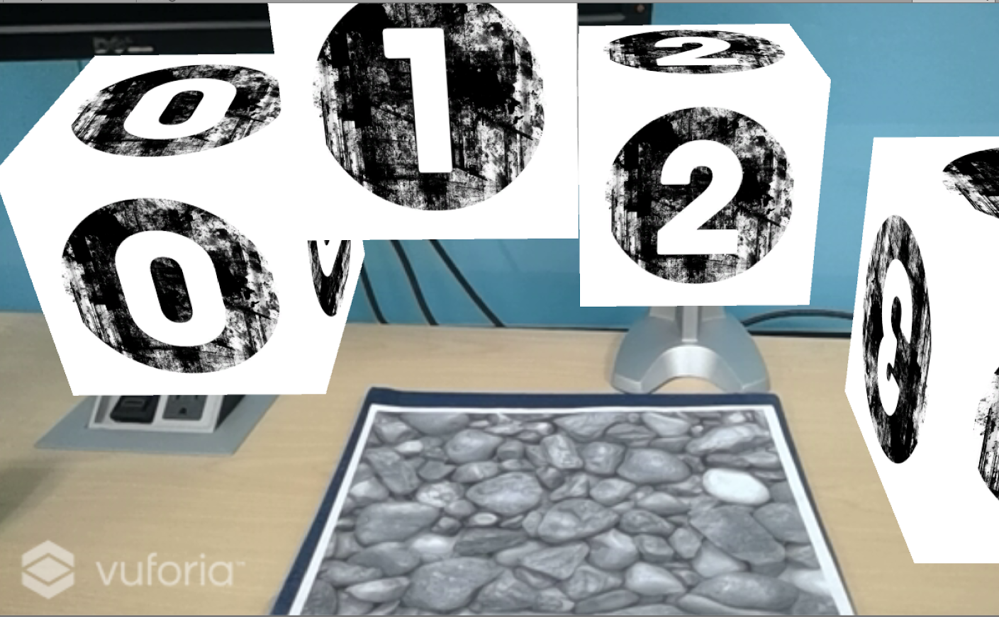
Requirements: Use Cases
Once the module has been selected an AR visualization manifests.
Notes:
5 seconds
Show the Use Case Diagram for the whole project. Highlight your use cases.

Slide 5
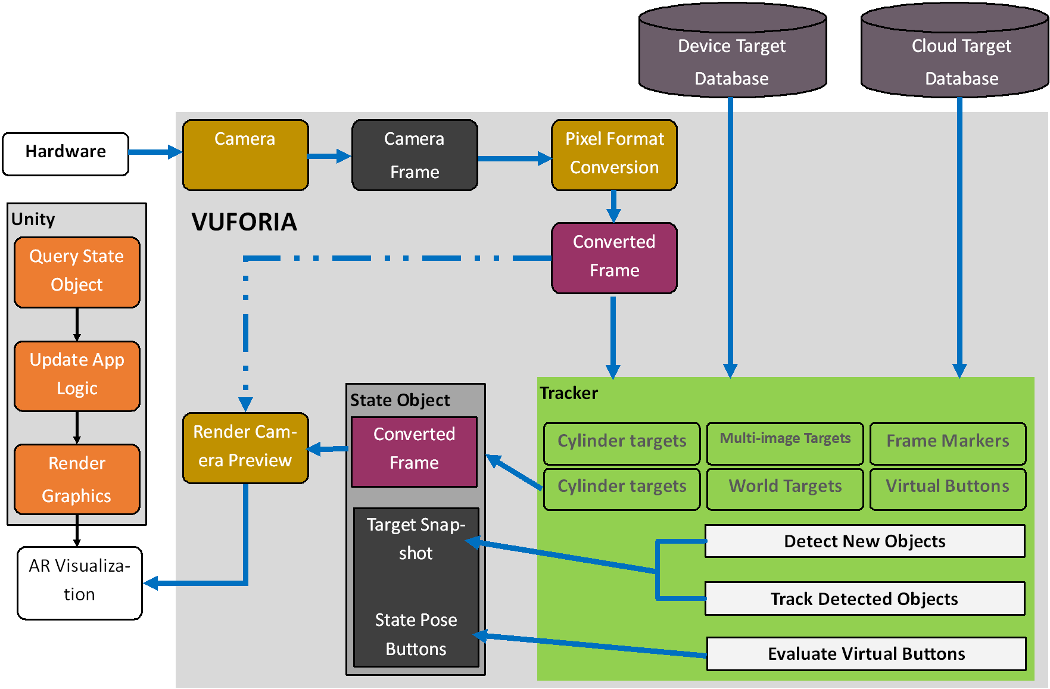
System Design: Architecture
Notes:
20 seconds
System design: Highlight the parts that you contributed to them.
1. System decomposition; identify the architecture patterns used
2. System deployment – h/w and s/w requirements

Slide 6
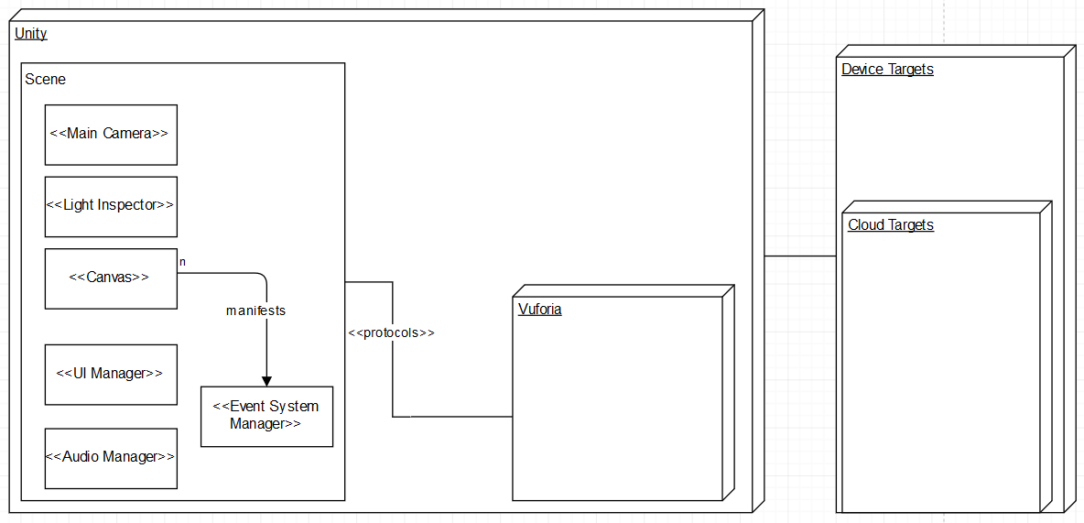
Minimal Class Diagram
Notes:
10 seconds.Minimal class diagram. Highlight the classes that you created/modified
Identify the design patterns used (one or more slides).

Slide 7
User Stories
1. #1159 - Learning the Unity Game Engine
2. #1213 - Prototype UI
3. #1185 - Research topics about augmented reality & education
4. #1240 - Windows/Android Deployment
5. #1158 - Learning the Unreal Engine 4
Notes:
5 seconds.
List the user stories that you worked on them.(put in order of importance). Stay focused on the parts that you have been working.

Slide 8


#1159 - Learning Unity Game Engine
AR Marker designing and learning basic Unity tools to produce animations and textures.
Notes:
60 seconds
The tile of user story
The most important user story you worked on it. You have to describe this one very well and be proud of that.
Please present and show the complexity of your work, code, algorithms, and technical challenges and technologies you have used. (you could use screenshot if you want. Visual presentations are better than text presentation)
Go into the details of the most important/significant tasks using bullet lists or visual graphs or state chart diagram
Sequence Diagram for this user story is mandatory (in another separate page if required)
Demo using screenshots or GIF (in another separate page if required)

Slide 9
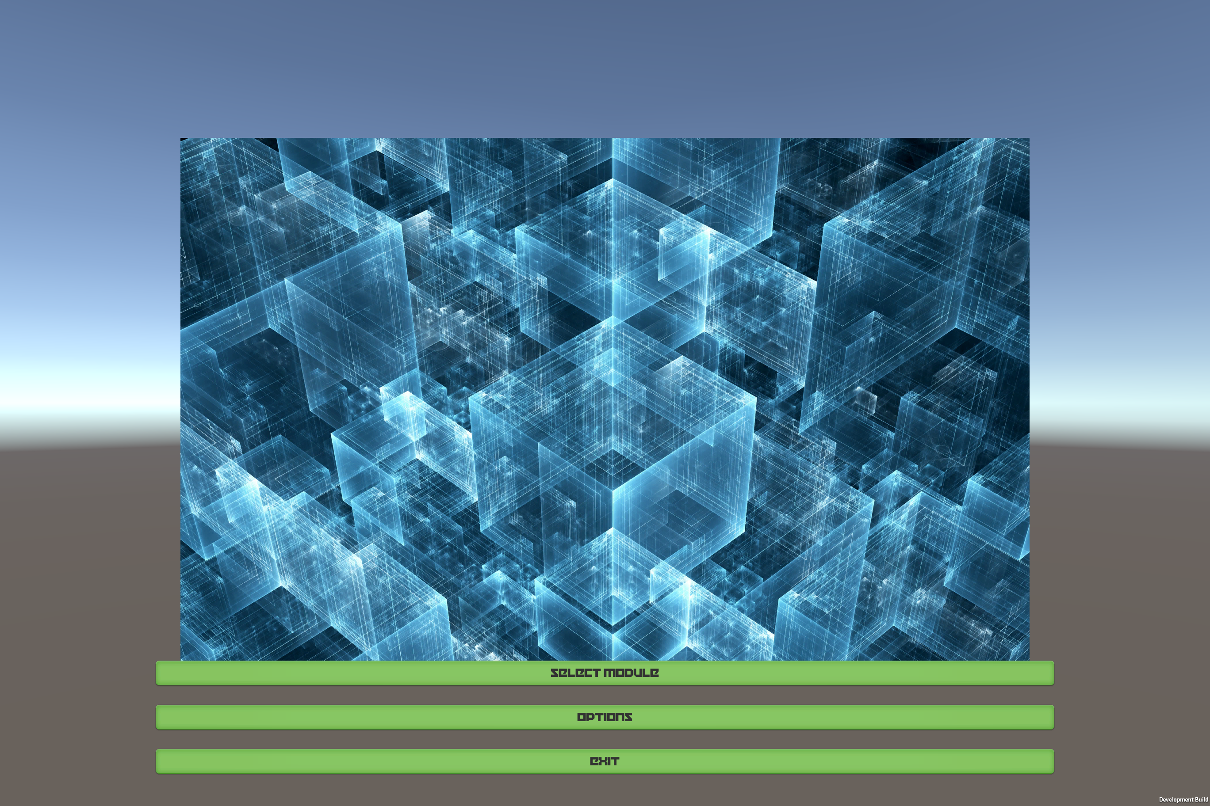
#1213 - Prototype UI
Creating a UI to allow the user to select what they features.
Notes:
20 seconds
The tile of user story
Please present and show the complexity of your work, code, algorithms, and technical challenges and technologies you have used. (you could use screenshot if you want. Visual presentations are better than text presentation) - Go into the details of the most important/significant tasks using bullet lists or visual graphs or state chart diagram - Demo using screenshots or GIF (in another separate page if required)
Sequence Diagram for this user story is optional

Slide 10
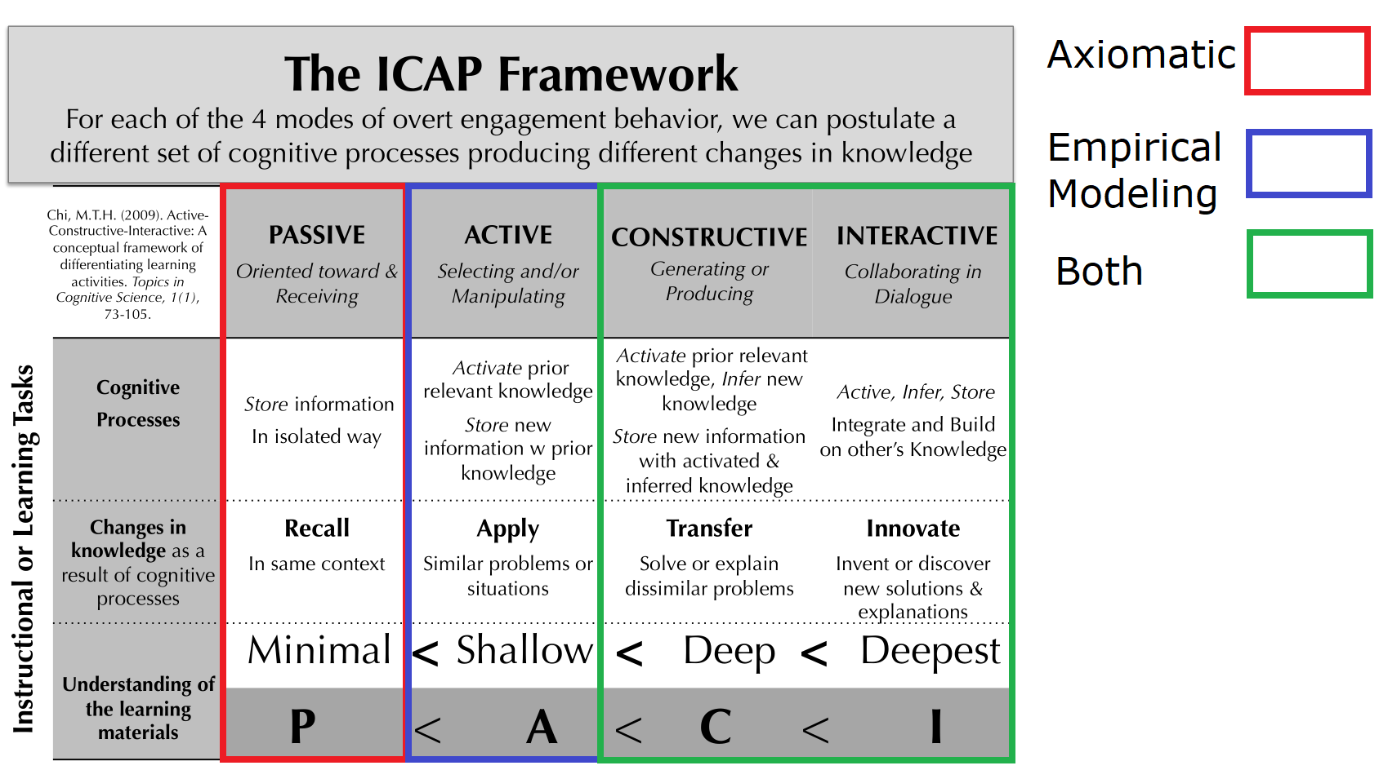
#1185 - Research topics about augmented reality & education
Good for learning mathematic and computer science.
Notes:
20 seconds
The tile of user story
Please present and show the complexity of your work, code, algorithms, and technical challenges and technologies you have used. (you could use screenshot if you want. Visual presentations are better than text presentation) - Go into the details of the most important/significant tasks using bullet lists or visual graphs or state chart diagram - Demo using screenshots or GIF (in another separate page if required)
Sequence Diagram for this user story is optional

Slide 11
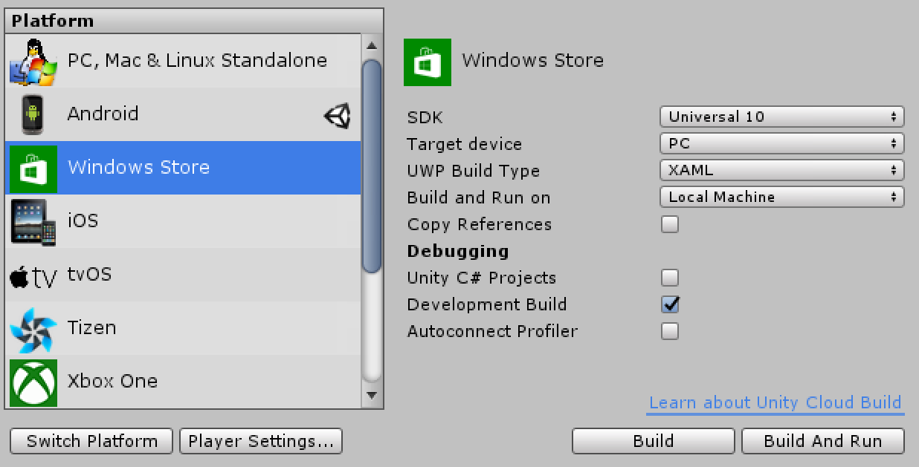
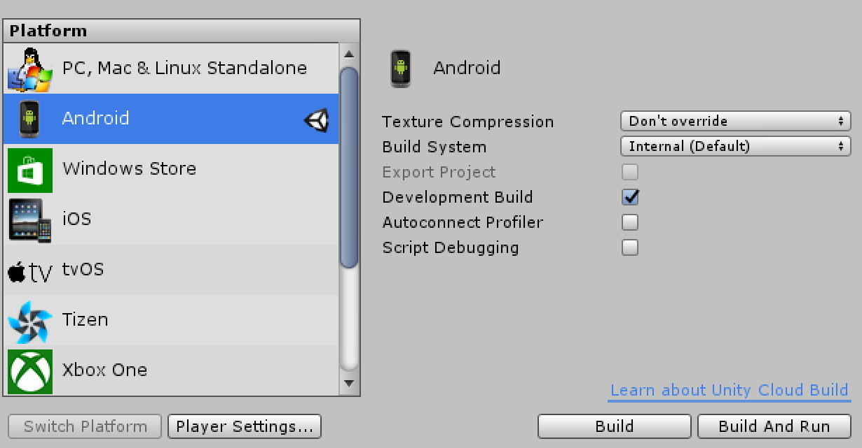
#1240 - Windows/Android Deployment
Realization of application to functional environment.
Platforms available: Windows Store, Android, iOS.
Notes:
20 seconds
The tile of user story
Please present and show the complexity of your work, code, algorithms, and technical challenges and technologies you have used. (you could use screenshot if you want. Visual presentations are better than text presentation) - Go into the details of the most important/significant tasks using bullet lists or visual graphs or state chart diagram - Demo using screenshots or GIF (in another separate page if required)
Sequence Diagram for this user story is optional

Slide 12
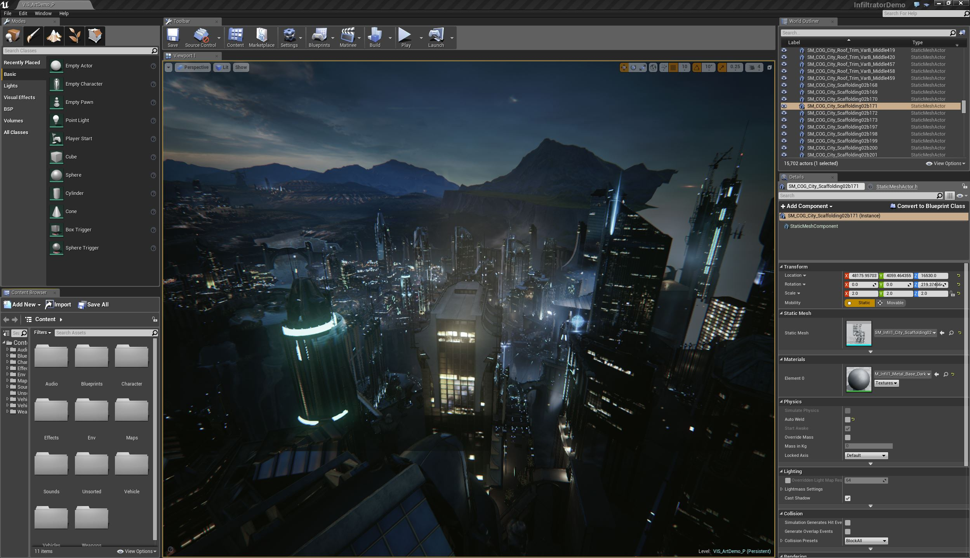
#1158 - Learning Unreal Engine 4
Notes:
20 seconds
The tile of user story
Please present and show the complexity of your work, code, algorithms, and technical challenges and technologies you have used. (you could use screenshot if you want. Visual presentations are better than text presentation) - Go into the details of the most important/significant tasks using bullet lists or visual graphs or state chart diagram - Demo using screenshots or GIF (in another separate page if required)
Sequence Diagram for this user story is optional

Slide 13
Test Suites and Test Cases
Using Unity Test Tools we performed System Testing on UI Elements.
ID | UT1265-1
Purpose | Sunny-day test to check whether there is a loading scene every time a scene changes to confirming that a scene-change took place.
Precondition | User must be at a static scene where no loading is taking place.
Input | User clicks on ‘Start’, ‘Exit’, ‘Options’, or ‘Back’ button.
Expected Output | Whenever there is a scene transition, there must be some feedback to the user that the scene is changing and that loading is taking place.
Status | PASS
ID | UT1265-2
Purpose | Rainy-day test to check that there is no unintended loading or scene change unless initiated by the user.
Precondition | User must be at a static scene where no loading is taking place.
Input | User clicks anywhere but the ‘Start’, ‘Exit’, ‘Options’, or ‘Back’ button.
Expected Output | No scene transition takes place since no loading has taken place.
Status | PASS
Notes:
10 seconds
A description of verification process and Test Suites and Test Cases for one of the use cases.
1 One sunny day and one rainy day for the implemented use cases (one or more slides).
2 Automated test scripts for the implemented use cases (if any) (one or more slides).

Slide 14





Summary
Augmented Reality education is a great tool for students, allowing them to learn at their own pace and keeps the student self-motivated when they successfully complete their task.
Contact:
Tom Lam | tlam008@fiu.edu
Ramses Sanchez | rsanc049@fiu.edu
Notes:
10 seconds
Summarize your contribution, mention your effort for Scrum, Mingle, Github, Google Drive Documentation and minutes
Include your contact information
Ask if anyone has any questions for you.
Thank your audience

